Slide 1


AIT : MBA – Apex Institute of Management
Subject Name – Managerial Economics
Faculty Name : Ashish Kumar
Topic : Economic Analysis of South Korea
DISCOVER . LEARN . EMPOWER

Slide 2
TEAM MEMBERS
Anniket Vats (22MBA20389)
Deepanshu Garg (22MBA20392)
Vijyant Singh (22MBA20243)
Taniya Saini (22MBA20353)
Neha Malik (22MBA20391)

Slide 3
ECONOMY OVERVIEW
Population - 51.8 million (2023)
GDP per capita - US $33,393 (2023)
GDP - US $1.6 Trillion (4th Largest in Asia as of 2023)
Currency - South Korean Won (KRW, ₩)
Central Bank - The Bank Of Korea
Fiscal Year - 1 January to 31 December
Country group - Developed/Advanced; High-income economy
Debt to GDP ratio - 39.8% (2020)
Foreign Reserves - $458.700 billion (July 2021)
All these parameters tells us the South Korean Economy right now is in good shape.

Slide 4
HISTORY
South Korea formed by the conclusion of the Korean war which separated the Korean Peninsula into 2 parts; North and South.
During the Cold War, the US Government funded South Korea heavily in order to prevent communism there. As a result, the South Korean Economy grew rapidly.
In the 1950s, South Korea was a very poor developing country. Its GDP per capita at end of Korean War was less than $800. However, by 2019, it increased by more than 12 times.
South Korea does not have any Natural Resources because they were found in Northern peninsula of Korea which comes under North Korea.
South Korean Economy grew rapidly from 1960 after economic reforms.
The Economic Miracle of South Korea is known as “the miracle of the Han river”.

Slide 5
GOVERNANCE AND TRADE
South Korea is a Constitutional Democratic Republic whose policies are shifted more towards Capitalistic Economy with little intervention in the market.
South Korea’s current President is Yoon Suk Yeol and their Finance minister Choo Kyung Ho.
South Korean Government spends the highest amount of money in Research And Development in proportion to their GDP. It was 4.8%
Exports were US $542 Billion in and Imports were US $503 Billion in 2020; meaning that they had trade surplus of US $41 Billion in 2020.
South Korea’s Exports are increasing each year because of ever increasing demands of Korean Products due to affordable cost and quality.

Slide 6
TRADE
The country exports mainly Electrical and electronic equipment (31% of total exports in 2021), machinery, nuclear reactors, boilers (13%), vehicles other than railway, tramway (11%), plastics (6.2%), Mineral fuels, oils, distillation products (5%) and optical, photo, technical, medical apparatus (3.9%) of their total Exports.
Major Export and Import partners of South Korea are China, The United States and The European Union (EU).
In Asia, their largest trading partners are China, Japan and Phillipines.
South Korea is maintaining a trade surplus from several years through which their economy is benefitting.

Slide 7
BALANCE OF PAYMENTS
Currency Exchange – 1 Indian Rupee is equal to 16.32 Korean Won as of October 2022 and 1 Korean Won is equal to 0.06 Indian Rupee.
Foreign Direct Investment (FDI) increased by US $468.8 Million in Sep 2022.
South Korea Direct Investment Abroad expanded by US $4.8 Billion in Sep 2022.
Its Foreign Portfolio Investment increased by US $8.3 Billion in Sep 2022.
In 2021, the total assets of domestic banks in South Korea amounted to approximately 3,275 trillion South Korean won, showing an increase compared to the previous year.
The financial sector accounts for an increasingly large share of the South Korean economy, the total assets of domestic banks in South Korea has steadily increased in the last years.

Slide 8
UNEMPLOYMENT
Unemployment was 2.6% as of June 2023; which is one of the lowest in the world.
Being Asia’s fourth-largest economy, the country's booming exports have helped to maintain the unemployment rate very low by the standards of developed countries.
A multitude of practices concerning gender inequality has led to a larger unemployment rate of women in the workforce of South Korea.
The Government tackles the problem of Unemployment by Setting out temporary welfare programs and active labor market policies, including public works, for the unemployed.

Slide 9
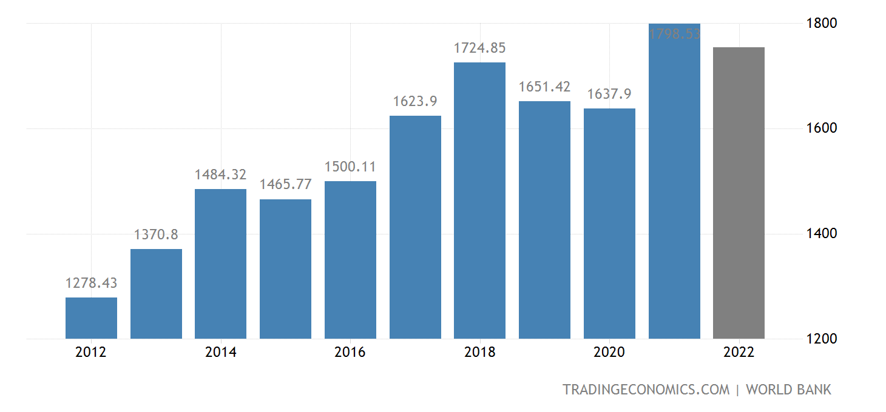
GDP GROWTH
Here Y Axis represents the
GDP size in billion dollars
And X Axis represents Years.
We can see Contraction in
GDP from 2019 to 2020 due
To Covid Pandemic, but they
Quickly recovered in 2021.
Before the Pandemic, the Korean
Economy was Growing swiftly.

Slide 10
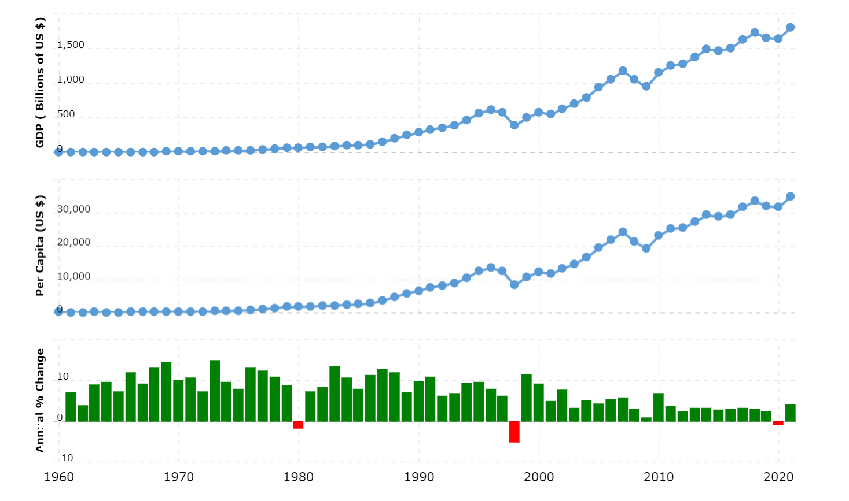
GDP GROWTH

Slide 11
SOFT POWER
The Soft Power of South Korea is Korean Pop and Korean Drama; which are famous all around the World.
The Korean Pop (also known as K-Pop) Industry generates more than US $10 Billion each year for the South Korean Economy.
The prominent groups of Korean Entertainment Industry are BTS and Blackpink; these groups represented Korean culture in the World and generated Billions of Dollars.
The Success behind South Korea’s entertainment industry is that they pour huge amount of resources when making the content and make it original and relatable.

Slide 12
FUTURE
South Korea will enjoy healthy GDP growth for around 2 or 3 decades more.
After that, their shrinking population will have a significant impact on their workforce.
Decreasing active workforce will lead to stagnation or low GDP growth.
Rising living costs and interest rates will exert a negative effect on household spending and business investment into 2023.
South Korea's export-oriented economy is unlikely to find relief from external sources, as its main overseas markets face a period of slower growth.
So the Future of South Korean Economy looks bright in the short term but not in the long term, that is, if they doesn’t come up with effective policies.

Slide 13

THANK YOU

